Slide 21
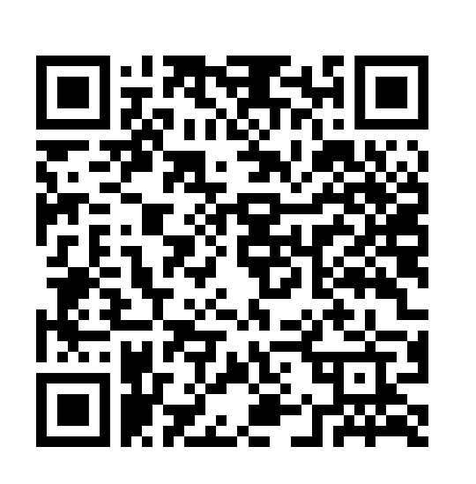

Slide 22
Elections begin on Thursday, July 4th
at 10:15 AM

